Slide 1
Why You Should Participate In a Hackathon
Sarah Withee
University of Missouri-Kansas City

Slide 2
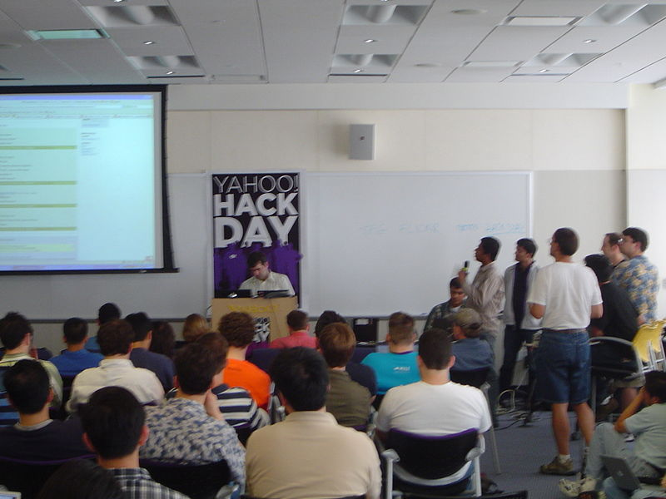
What is a Hackathon?
“Hack” and “Marathon”
A short programming competition, usually an afternoon to a week long
Often groups of one to five people
Design a working app/site from scratch
Demo the app/site to the other developers/judges
Often sponsored by various companies hoping you will use their API
Some are devoted to certain social causes
Others are internal to companies

Slide 3
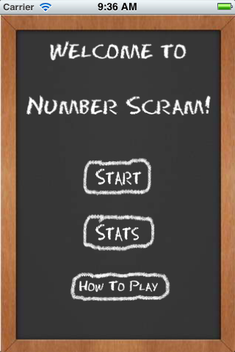
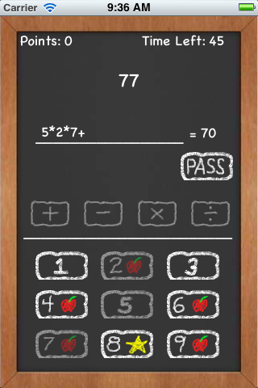
Number Scram
Number/math game for iPhone
Available on the iTunes store
My team created in less than 24 hours
Won “Best Mobile App” at Hack the Midwest 2012

Slide 4
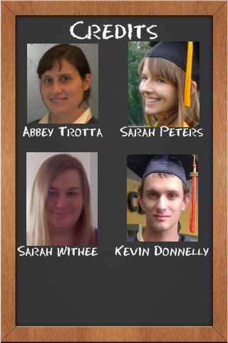
Reason 1: Experience
Work in a team atmosphere
Practice good design from start to finish
Learn new APIs
Develop with a deadline
Present your new product to others

Slide 5
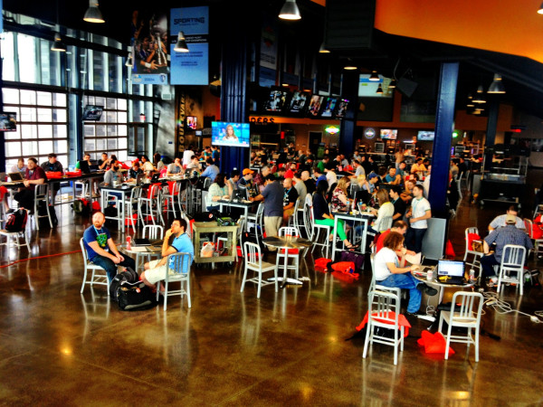
Reason 2: Networking
Meet other professionals in the field
Meet new friends
See other awesome projects people are working on
Maybe find something you want to join in on

Slide 6
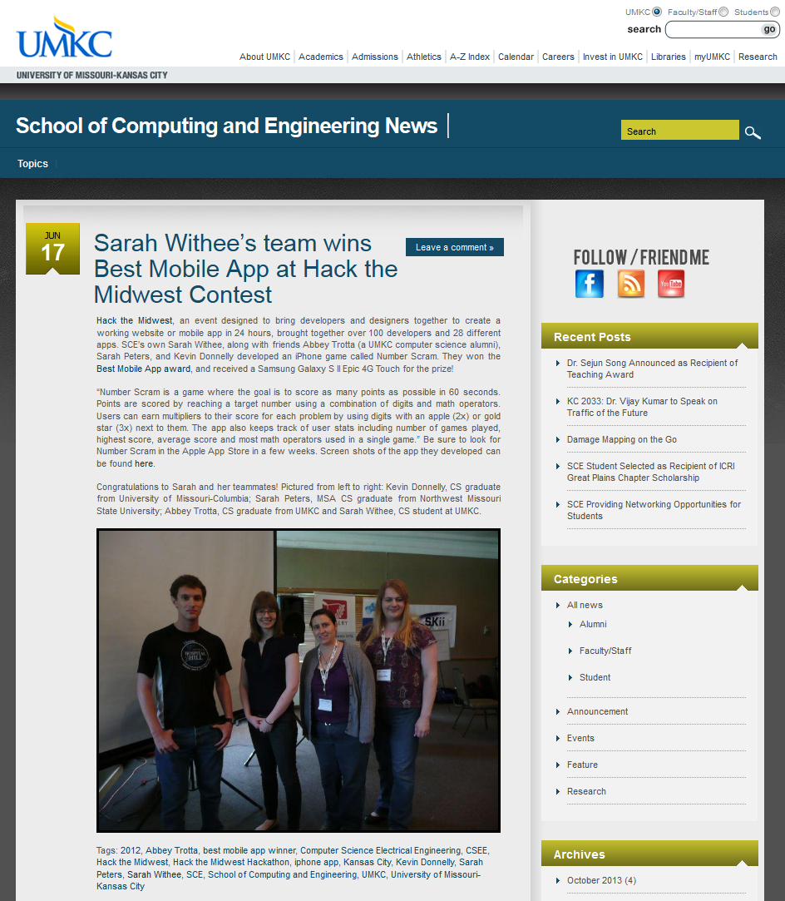
Reason 3: Bragability
Great event to put on a resume
Even better if you win a prize
Tell your friends you have an awesome app, and have them use it
Invent new words like “bragability”

Slide 7
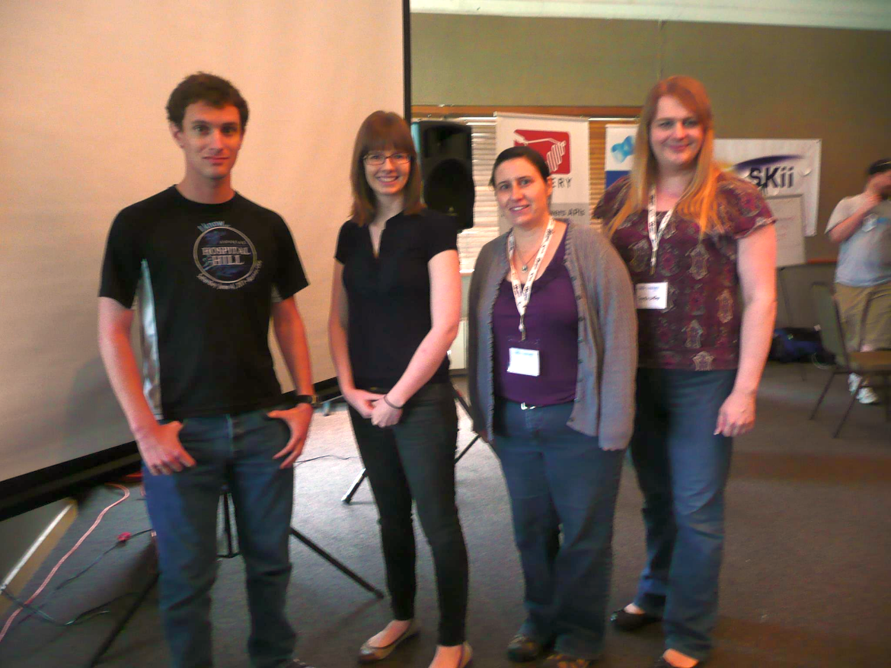
Reason 4: Fun!
Spend time away from school
Do awesome projects
Build camaraderie with your friends and others
Show that women can code just as well as men
and of course…
Free swag
Free food and drinks

Slide 8
More info
HackerLeague (Site listing hackathons around US/world): https://www.hackerleague.org/
Missouri: Hack the Midwest (KC): http://www.hackthemidwest.com Compute Midwest (KC): http://www.computemidwest.com Globalhack (St. Louis): http://globalhack.org/ Joplin Hackathon: http://www.joplinhackathon.com
Iowa: Women’s Hack Day (Univ. of Iowa): http://www.meetup.com/IowaTechChicks/ MacDonald Hackathon (Des Moines): http://oldmacdonaldhackday.com/

Slide 9
Questions?
I’ll post slides to www.sarahwithee.com
twitter.com/geekygirlsarah
linkedin.com/in/sarahwithee

